Slide 1




BaaS and Parse.com
Creating Cloud-Based REST Services Backend
SoftUni Team
Technical Trainers
Software University
http://softuni.bg

Slide 2


Table of Contents
Cloud Overview: IaaS, PaaS, SaaS, BaaS
Backend-as-a-Service (BaaS) Overview
Parse.com
Accessing REST Services from JavaScript

Slide 3







What is a Cloud?
HTML 5
coding
Java
Python
PHP
JavaScript
Ruby
Cloud for Developers
IaaS, PaaS, SaaS and BaaS Models

Slide 4

What is BaaS (MBaaS)?
BaaS Clouds. Typical BaaS Services

Slide 5
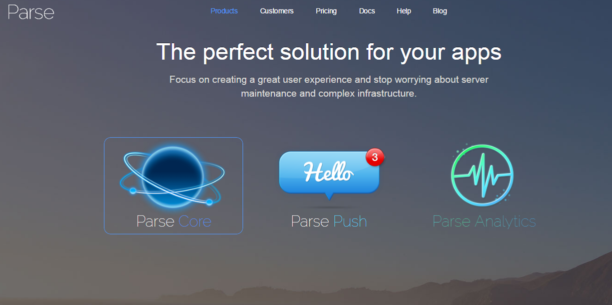
Parse.com
Public BaaS Cloud

Slide 6

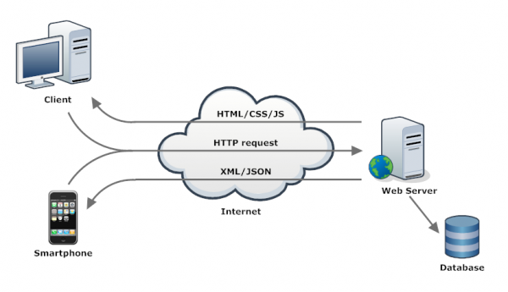

Accessing REST Services from JavaScript and jQuery

Slide 7







BaaS and Parse.com
https://softuni.bg/courses/javascript-applications/

Slide 8
License
This course (slides, examples, demos, videos, homework, etc.) is licensed under the "Creative Commons Attribution-NonCommercial-ShareAlike 4.0 International" license
Attribution: this work may contain portions from
"JavaScript Applications" course by Telerik Academy under CC-BY-NC-SA license

Slide 9





Free Trainings @ Software University
Software University Foundation – softuni.org
Software University – High-Quality Education, Profession and Job for Software Developers
softuni.bg
Software University @ Facebook
facebook.com/SoftwareUniversity
Software University @ YouTube
youtube.com/SoftwareUniversity
Software University Forums – forum.softuni.bg

